Slide 1
Congestion Control Framework based on
In-Network Resource Pooling

Slide 2
The Resource Pooling Principle
“Pooling of customer demands, along with pooling of the resources used to fill those demands”
“networked resources behave as a pooled resource”
Pooling can be thought of as a tool to manage uncertainty.
Internet (among others): a network of resources
  From bandwidth, computation and storage resources, to information/content and service resources
Uncertainty in the Internet (among others):
  Senders overloading the network with traffic
  Excessive demand for bandwidth over some particular link/area

Slide 3
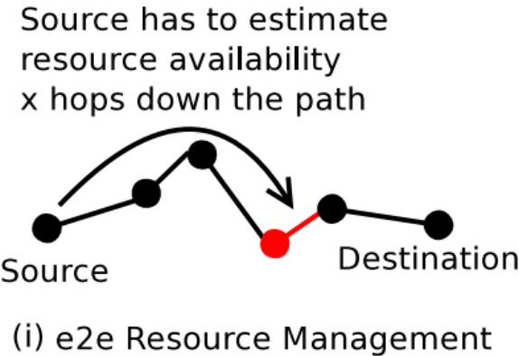
Current State of Affairs
The Long Long Discussion on TCP
TCP deals with uncertainty using the “one-out one-in” principle
TCP effectively deals with uncertainty by (proactively) suppressing demand!
TCP is moving traffic as fast as the path’s slowest link
End-points have to speculate on the resources available along the e2e path

Slide 4
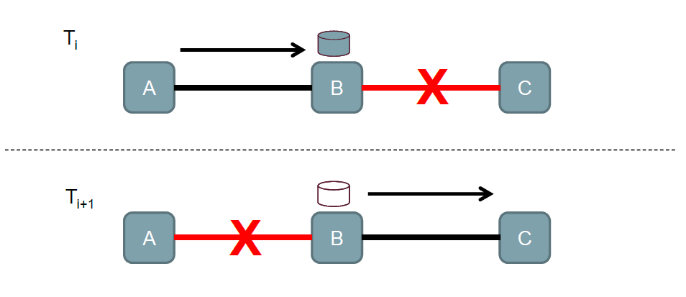
Caches and resource pooling
The presence of ubiquitous packet caches enables more efficient usage of resources by enabling pooling of subpaths.
3. Exploit all available (sub-)paths making decisions on a hop-by-hop manner.
2. Store traffic temporarily in custodian nodes/routers and deal with congestion locally
1. Push traffic as far in the path and as fast as possible

Slide 5
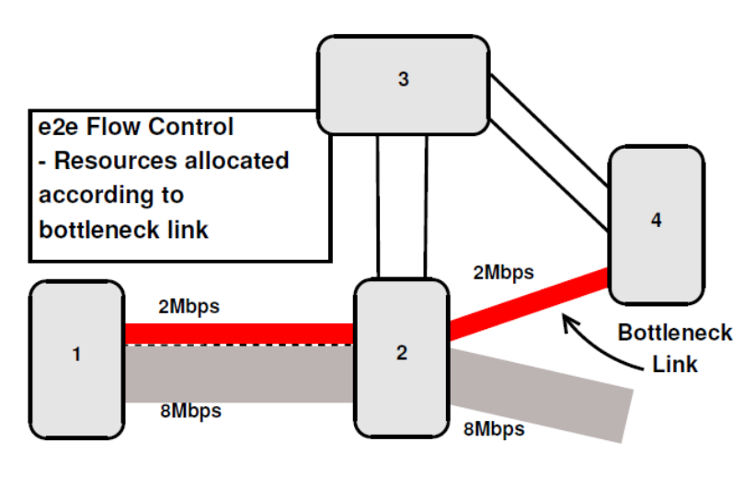
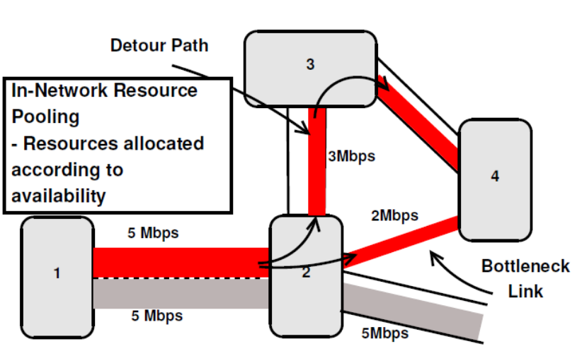
Resource pooling

Slide 6
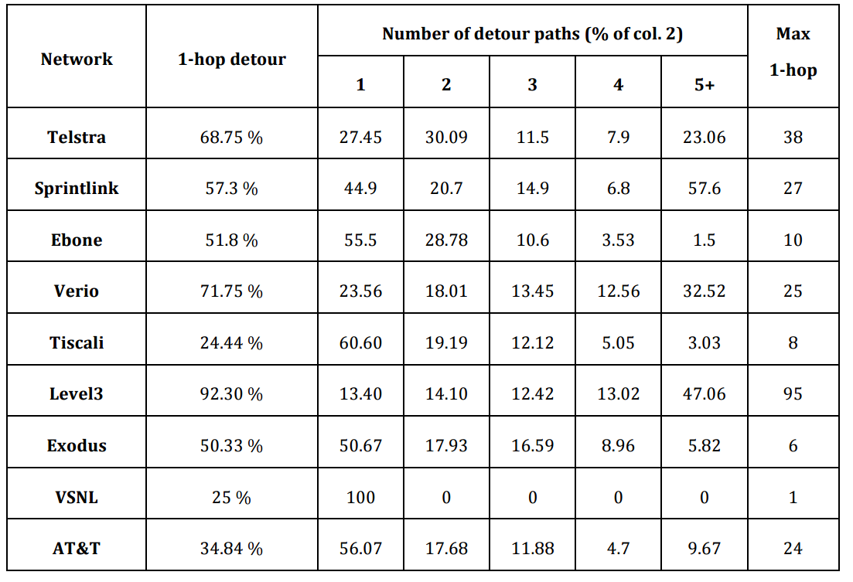
Data on detour availability

Slide 7
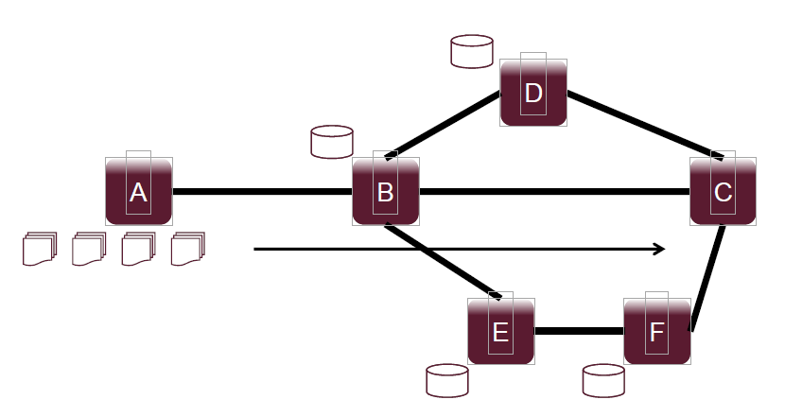
3-Phase Operation
Push-data phase – Open-Loop System
  Processor-sharing, RCP-like transmission
  Open loop system – senders send even more than what they have received requests for
    Push data as far and as quickly as possible

Slide 8
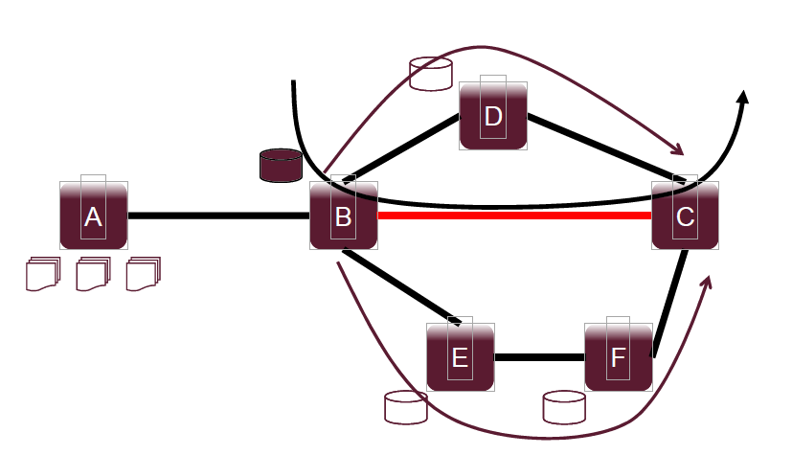
3-Phase Operation
Cache & Detour phase
  Every router monitors incoming Requests
  When demand is expected to exceed supply, the local router tries to find alternative paths to detour
  In the meantime traffic in excess (if any) is cached locally

Slide 9
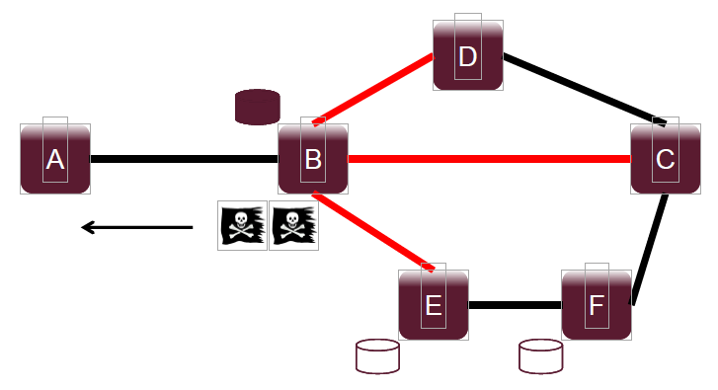
3-Phase Operation
Backpressure phase – Closed-Loop System
  If alternative paths do not exist or are equally congested:
    Pace Requests
    Send notification upstream to slow down and enter closed-loop transmission

Slide 10
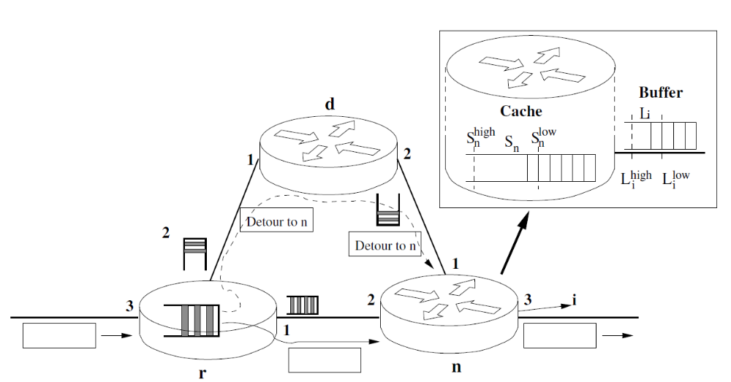
Congestion control phase 1 (D4.1)
INRPP over IP networks
  We limit detour paths to 1-hop detours only
  We determine multiple states per iface: Push, Store & Detour, Backpressure or Disable backpressure.
  We monitor iface buffers to detect congestion and cache occupancy to start backpressure.
  We index cache per flow (using 5-tuple)

Slide 11
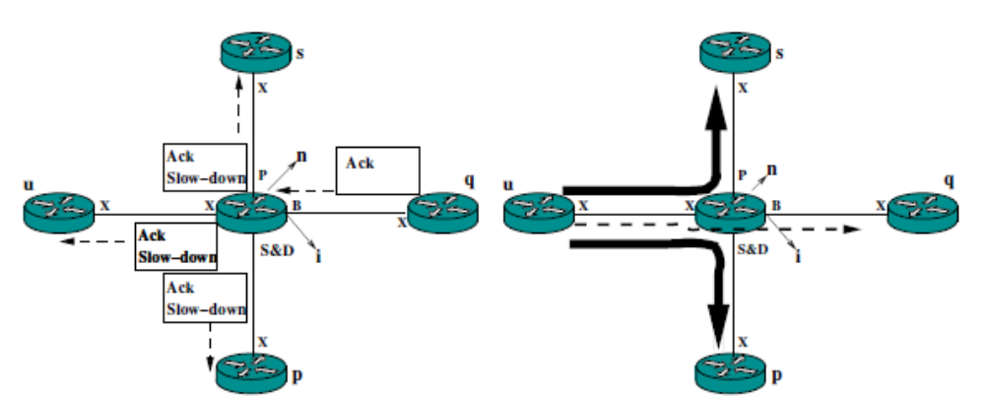
Congestion control phase 1 (D4.1)
INRPP over IP networks
  When cache is full INRPP notifies upstream router through Acks and starts Closed-Loop (CL) with previous node.
  Sender slows-down rate to ACK pace.
  The CL state is transmitted upstream until it reaches the TCP sender, that slows-down to ACK pace as well when all caches are full.

Slide 12
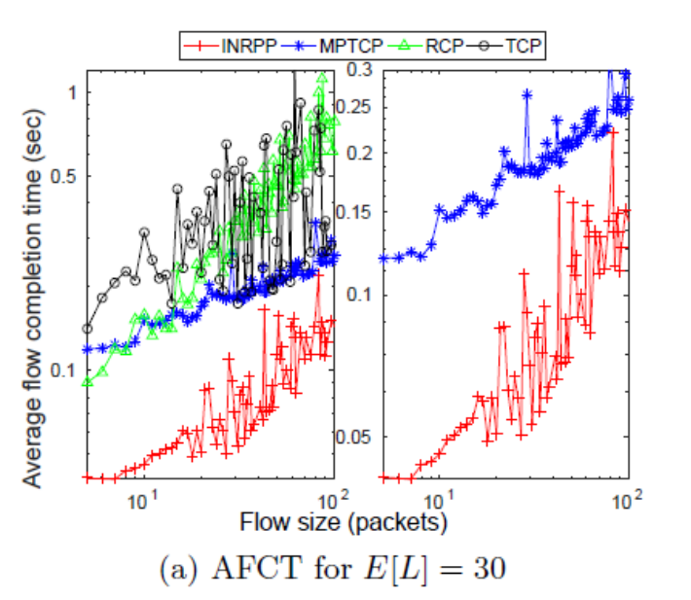
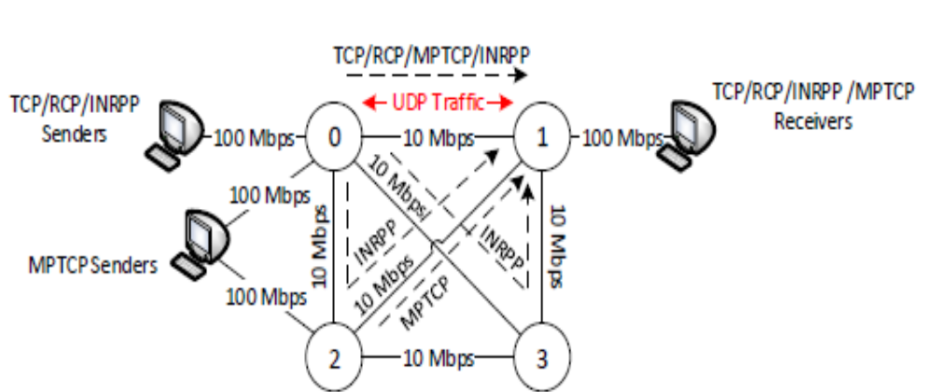
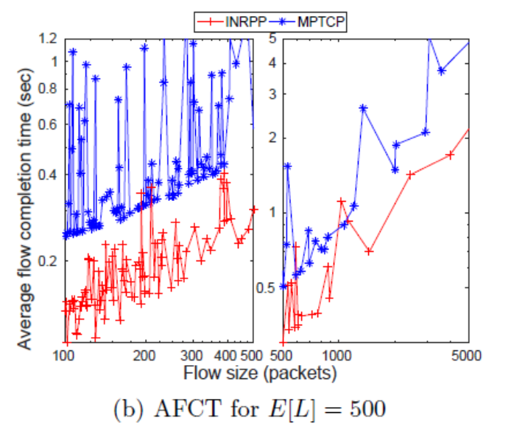
Some initial results
  Simple multihomed topology scenario

Slide 13
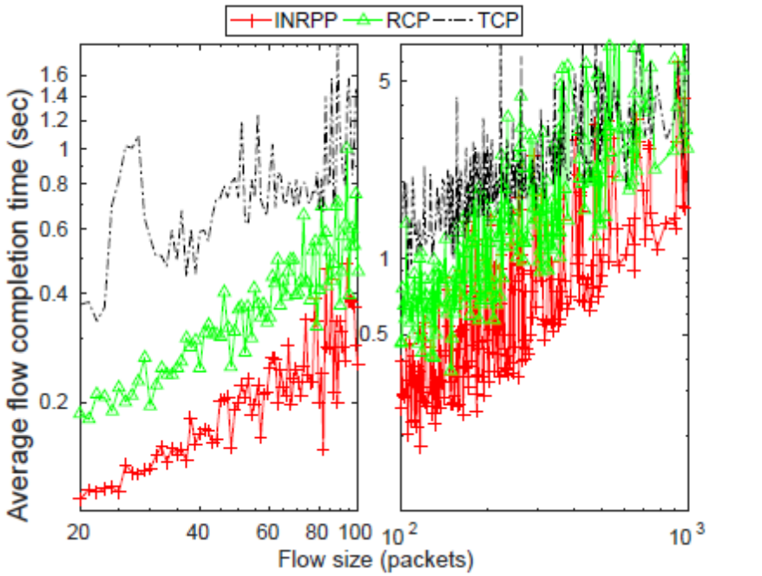
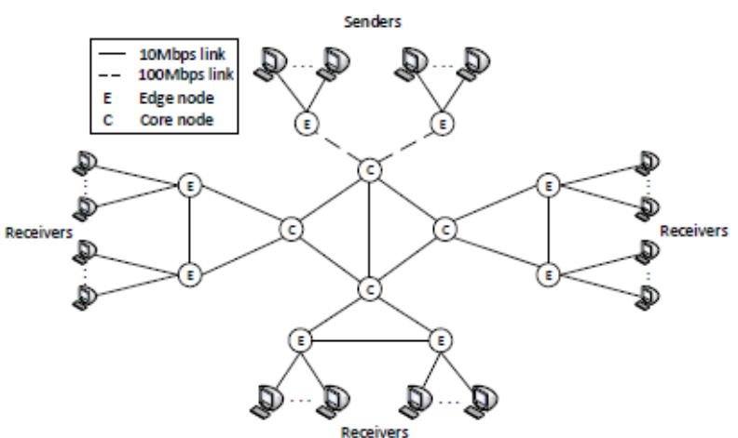
Some initial results
  Multi-domain topology scenario

Slide 14
Congestion control next phase (D4.2)
INRPP over ICN/NDN networks
  INRPP takes advantage of the built-in abstractions(transparencies) provided by the NDN.
  INRPP NDN design principles:
    We assume Interest packets and Data or Content chunks generated by receivers and senders, respectively.
    Data receivers will request data at the application rate, and for bulk data transfers an initial processor sharing rate will have to be set.
    After receiving the first few chunks of data, the receiver will continuously adjust its requesting rate to the incoming data rate.
    Applications will slow down and enter closed-loop transmission.
    Routers can detect congestion based incoming interests per interface.

Slide 15
Congestion control next phase (D4.2)
INRPP over ICN/NDN networks
  Known issues:
    Push services: Push services may not maintain 1-to-1 flow balance of interests and data chunks, which difficults rate control based on interests regulation.
    Wireless links: We cannot consider the capacity of a link as known and constant and disconnections or packet loss can be an issue.
    DTN opportunistic links: DTN tunnelling hinders the implementation of the INRPP
    Out-of-order delivery: out-of-order delivery is an important issue that we will need to be dealt with, in case of detouring path with different characteristics
    Pull multicast: On path caching allows router’s cache directly response without adding more traffic. We can take benefit from this issue, but we will need to better explore possible issues in terms of congestion control and fairness.

Slide 16
Thank you.
Questions?

